Slide 1
Hi Guys, Good Morning
Project Discussion

Slide 2

1) Selection of Projects Minimum Complexity
You should use all the concepts we studied till know (Variables, If, Loops, Arrays and Functions).
You are not allow to use other concepts we did not cover yet.

Slide 3
1(a) Users of your application
There should be at least 2 Users of your application like we did for messaging system
One user was Admin and other user was Agent

Slide 4
1(b)Total number of options in application ?
Your application should contain at least 10 menu option for both type of users
Like
Press 1 to add Product
Press 2 to Add Stock
Press 3 to Delete Product
Press 4 to Update Product
Press 5 to Search Product

Slide 5
Mandatory Features

Slide 6
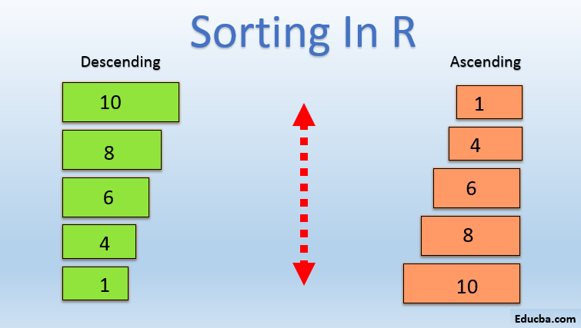
1(c)Sorting
Implementation of Sorting in your project is mandatory.
Like if you are making Product Sale Store Application your application should have options to display product by price lower to high and high to low, Or Stock sorting etc
Like if you are building a hospital management system your application should contain patient age vise sorting. Or medicine price sorting.

Slide 7
Recommendation Feature
There should be a recommendation feature in the application based on multiple if else decision tree.

Slide 8
History
Your application should maintain some kind of history data

Slide 9

2) Project Ideas ?
Mobile Shop Management System
Hospital Management System
Sports Shop Management System
School Management System
Tournament Management System
Employee Management System
College Management System
Book Store
Hotel Booking
Social Messaging Application
Hostel Management
Pharmacy Management.

Slide 10

3. How to Proceed for Project

Slide 11
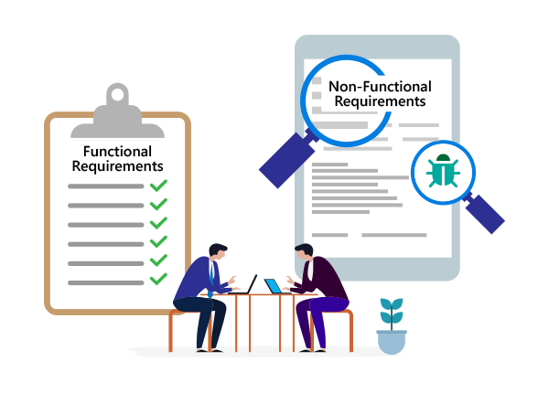
3.1 Writing Functional Requirements
For example we are Developing Medical Store Software
As an Admin, I shall add a new user so it can login to system and select from user options
As an Admin, I can add Products
As an Admin, I can Update and Delete Product
As Employee I can sale products
As Employee I can see Daily sale report
As Employee I can add Stock for product

Slide 12
Example of Functional Requirements
University Management System Functional Requirements
User must log-in with a username and password in order to use the system
Admin can Add students and Teachers
Teacher can add students
Students can See Mark and Register subjects.

Slide 13

3.2 Design WireFrames
You can make Wireframes using any Tool like Adobe XD or any other tool you are familiar.
You can draw Wireframes on your note book but use ruler for proper wireframes.

Slide 14



3.3. Get it approved.
Come up with all material we discussed in above slides and get it approved by Teacher
You may get rejected if your work did not satisfy the requirements we discussed above.

Slide 15
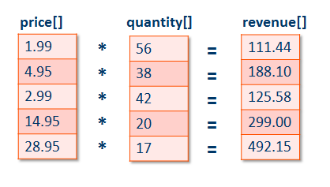
3.4 Identify the Data Structure (Arrays that hold information)

Slide 16
3.5 Identify Functions
Identify you functions in your project like you are developing University management system than some function will be
menu();
display_students ();
add_students();
sort_students_by_marks();
Other way of write function name
displayStudent();
addStudent();
sortStudentByMarks();

Slide 17
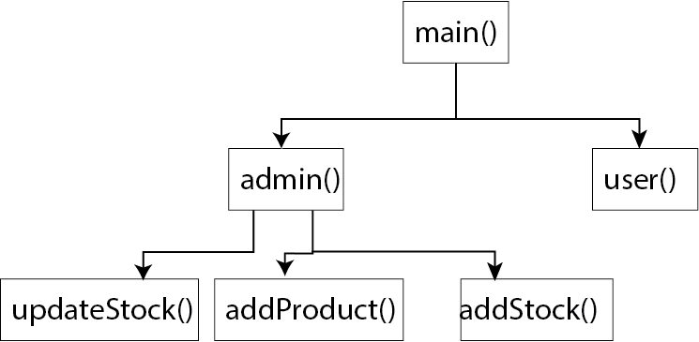
3.5 Make the Function Work Flow
In this step define which function will be call by which function

Slide 18
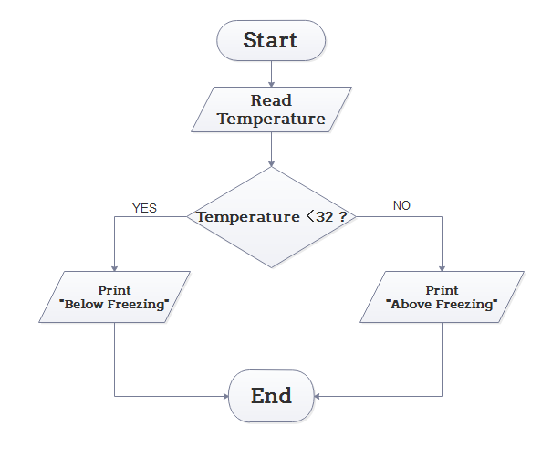
3.6 Write Algorithm and Draw Flow Chart for Each Function
Do this for individual function

Slide 19
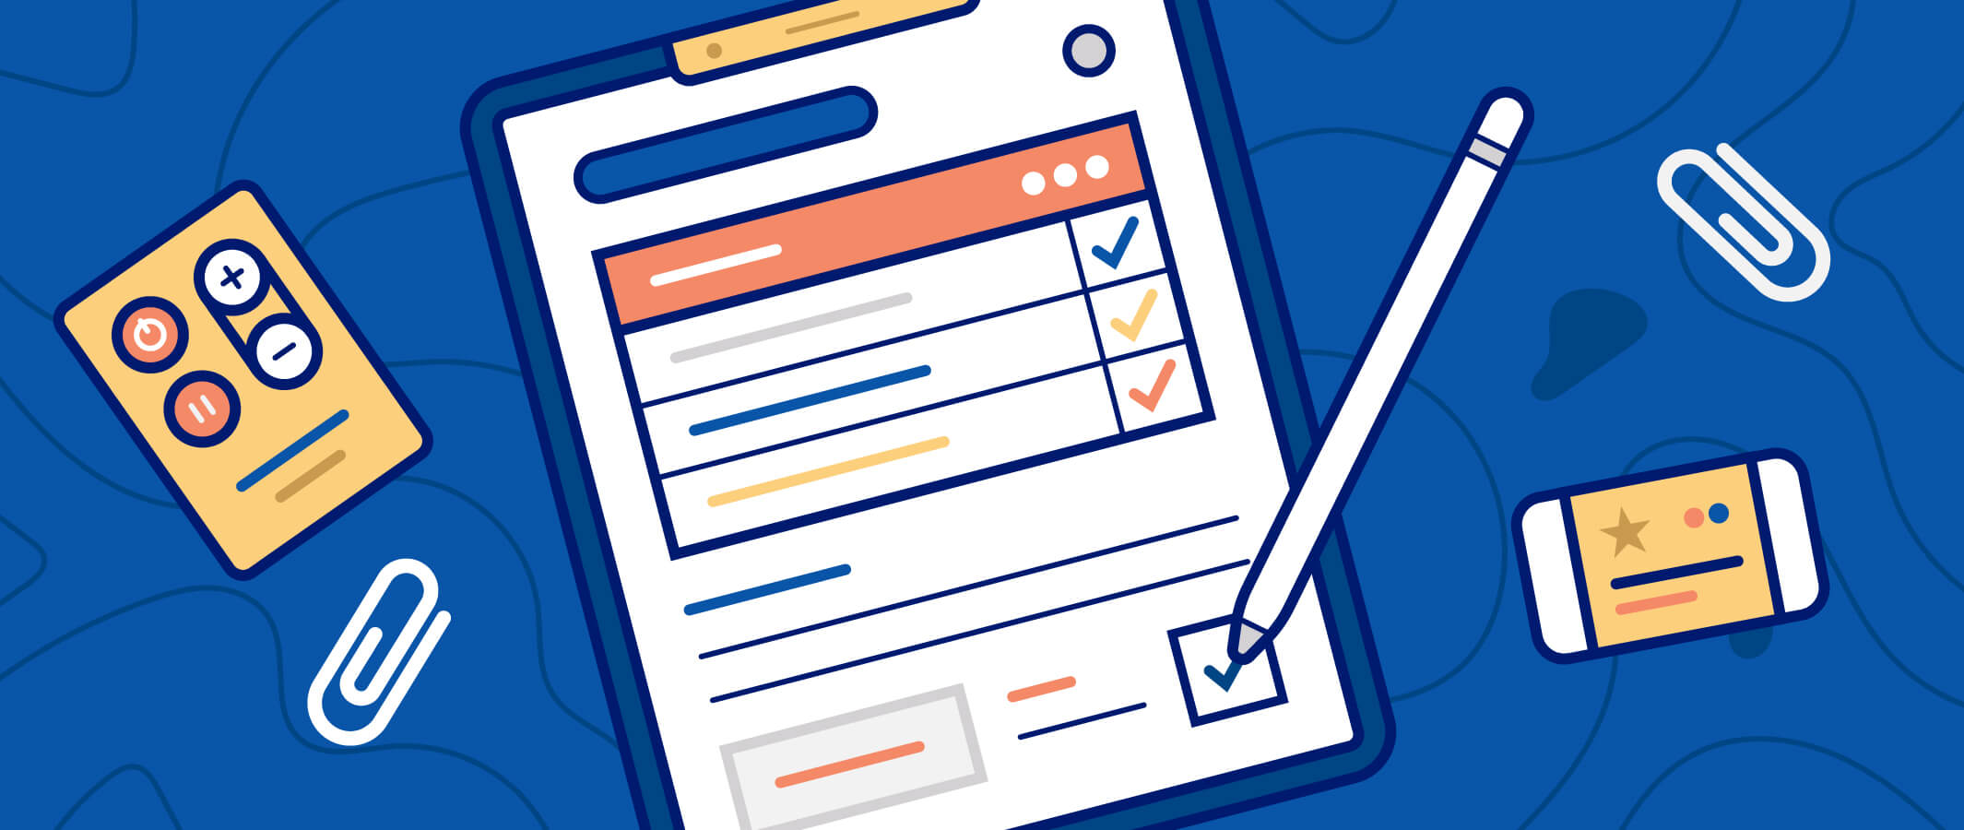
3.7 Final Documentation Template
Project Title (Cover Page) We will provide you the cover page template
Project Functional Requirements
Wireframes
Data structure identification
Functions identifications
Functions workflow
Algorithm and every function flow chart

Slide 20

4. Writing Code
Great you done most difficult part of your project.
Now lets move to easy and interesting part
Start writing code and make it happened.
But before start coding lets discuss some important professional practices for writing code

Slide 21
4.1 Coding Style

Slide 22
Variable and Function Names Conventions
Start variable and function name with small letter and spate two words use in variable by camel case or underscore.
For example to store product name in variable
product_Name OR produtName
For example to store student marks
student_marks OR studentMarks

Slide 23
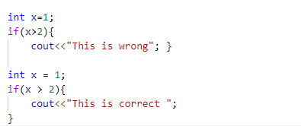
If condition

Slide 24
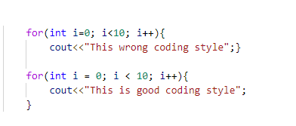
Loops

Slide 25
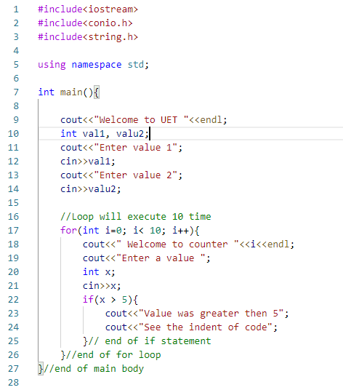

Slide 26
4.2 Variable Names
Variable names for your project should be relevant you are not allow to use variable names like a, b, c.
How to Choose variable name ?
Like you are developing Store Management Application your variable names should be relevant and give sense to code reader.
product_name
product_price
currentStock

Slide 27
4.3 Indentation
To enhance readability you code should be well indent like if you are writing something in for loop you all code inside for loop should have same indent. Indent mean gap of your code from Editor left side.
VS Code provide you auto indent if you do not remove it by user self.

Slide 28
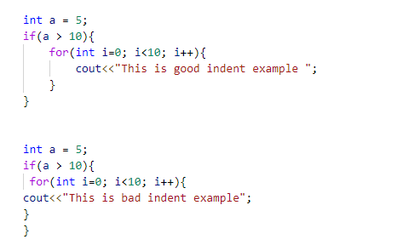
Good and Bad Indent Example

Slide 29
4.4. Comments within the code
Comments are very important part of professional coding. Make it your habit to write comment when write any logic even its hard or easy for your. Specifically write comment on each function header to define what is happening inside function.
Don’t write comment at end of project completion to satisfy just project requirements.
// One line comment
/*
This is multi line comment
*/

Slide 30
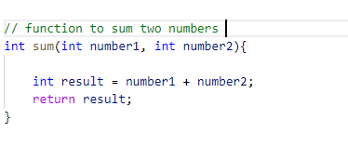
Example of Comment

Slide 31

Important Note
Points we discussed like coding style, comments, indentations etc. will be evaluated.

Slide 32
5. Project Display
Now your project is ready to Display to Audience.
Your Seniors, Your Department Teachers are your audience.

Slide 33
5.1 Poster
Design a poster for your project
We will provide you the basic template for poster, what to include and what not to include in poster

Slide 34

5.2 Presentation
Presentation Day
Come up with project and poster.
Get well dress.
Present your project.
Get your project review

Slide 35
6. Timeline with details
Milestone | Deadline
Functional Requirements + Wireframes | 9 November 2020 -> 1PM
Approval + Algorithm + Flow Charts of functions | 16 November 2020 -> 1 PM
Project Competition | 23 November 2020 -> 1 PM
Presentation | 25 November 2020 1 to 4 PM

